Slide 1



Multi-armed Bandits
+
Tom Vodopivec
IADS Analytics, Data Science & Decision Making Summer School 2022 2022-08-01

Slide 2
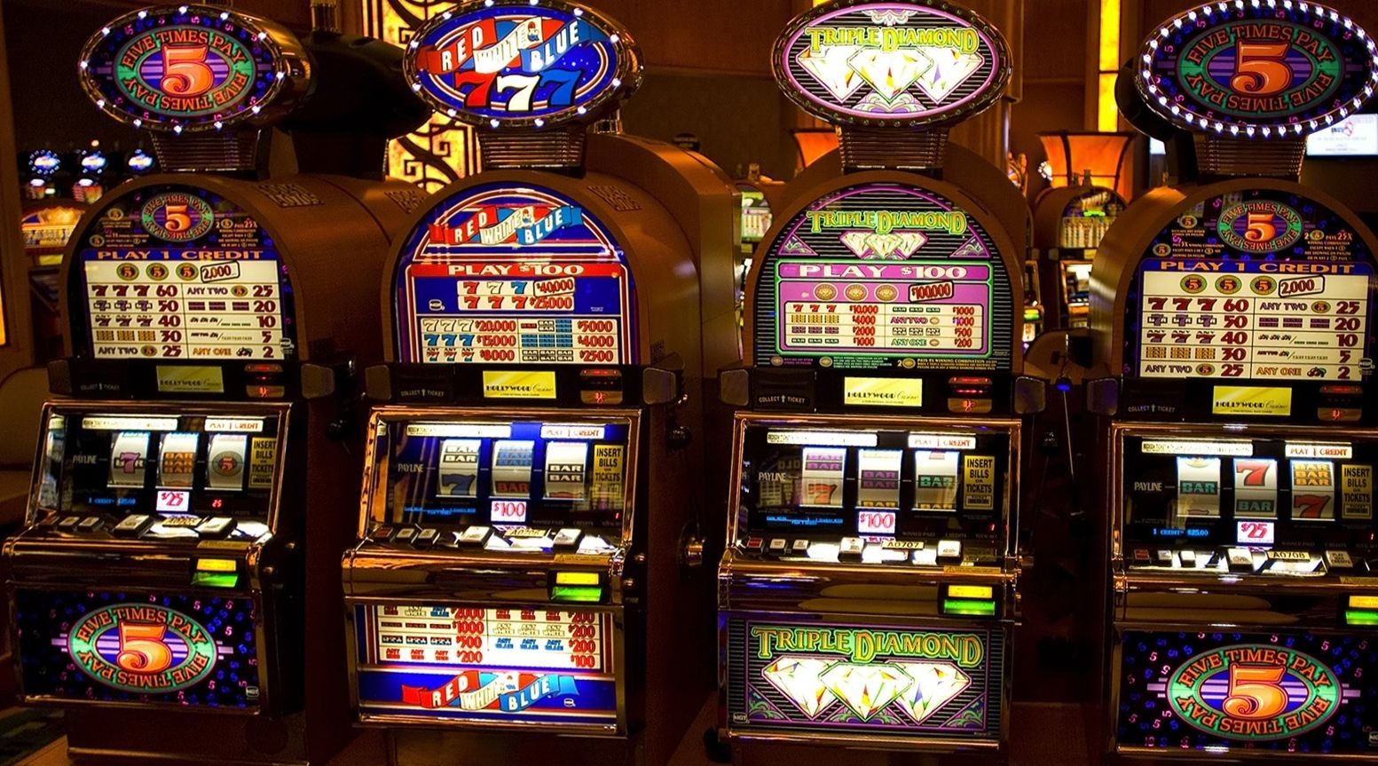

Bandits??
One-armed bandit
= slot machine
( because had an arm and robbed you of your money)
+
When you have more, which one has better odds?
Multi armed = you have several one armed machines. Maximize reward = still the goal -> so find the best arm to pull (i.e., which machine to play). They are all rigged but try to find the one who gives you best outcome.
2/8

Slide 3
Problem deﬁnition In probability theory and machine learning, the multi-armed bandit problem (sometimes called the K-^{[1]} or N-armed bandit problem^{[2]}) is a problem in which a fixed limited set of resources must be allocated between competing (alternative) choices in a way that maximizes their expected gain, when each choice's properties are only partially known at the time of allocation, and may become better understood as time passes or by allocating resources to the choice.^{[3][4]} This is a classic reinforcement learning problem that exemplifies the exploration–exploitation tradeoff dilemma. The name comes from imagining a gambler at a row of slot machines (sometimes known as "one-armed bandits"), who has to decide which machines to play, how many times to play each machine and in which order to play them, and whether to continue with the current machine or try a different machine.^{[5]} The multi-armed bandit problem also falls into the broad category of stochastic scheduling. https://en.wikipedia.org/wiki/Multi-armed_bandit
Single-state MDP
Maximize reward
+
Learn optimal policy
Exploration-exploitation trade-off

Slide 4
Types of Bandits
Stochastic
Adversarial (game theory and Nash equilibria)
Markovian (some underlying state space - use RL techniques)
+
Non-stationary
Budget-limited bandits
Contextual bandits (with covariates) Sleeping bandits
Many-armed bandits

Slide 5
Solutions (policies)
Epsilon-greedy
+
5/8

Slide 6
Solutions (policies)
Epsilon-greedy
Upper Conﬁdence Bounds (UCB)
Optimism in the face of uncertainty
Optimal in the limit
+
5/8

Slide 7
Solutions (policies)
Epsilon-greedy
Upper Conﬁdence Bounds (UCB)
Optimism in the face of uncertainty
Optimal in the limit
+
Thompson Sampling
Bayesian: draw samples from (Beta) distribution
Number of pulls of an arm should match probability of the arm being optimal
5/8

Slide 8
Performance Metrics
Cumulative reward
Regret
+
Probability of choosing optimal arm

Slide 9
Use in Marketing
A/B testing with real-time optimization
Pros (over A/B testing)
Faster identiﬁcation of best variant - more cumulative reward
Adapts to non-stationarity (no need to repeat A/B tests)
No need to select best variant manually (additional step at end of A/B test)
+
Cons (over A/B testing)
More difﬁcult to understand and to implement
More difﬁcult to measure beneﬁts

Slide 10
Reading Material
Kuleshov and Precup, Algorithms for the Multi-armed Bandit Problem
Auer et al., Finite-time Analysis of the Multiarmed Bandit Problem
+
morel and Mohri, Multi-Armed Bandit Algorithms and Empirical Evaluation

